Slide 2
Short overview of the Horizon Europe Work Programme 2025
PROPOSAL WRITING CAMP

Slide 3
HORIZON EUROPE – SHORT OVERVIEW
SPECIFIC PROGRAMME IMPLEMENTING HORIZON EUROPE & EIT*
Exclusive focus on civil applications
Pillar I
EXCELLENT SCIENCE
Pillar II
GLOBAL CHALLENGES & EUROPEAN INDUSTRIAL COMPETITIVENESS
Pillar III
INNOVATIVE EUROPE
European Research Council
Health
Culture, Creativity & Inclusive Society
Civil Security for Society
Digital, Industry & Space
Climate, Energy & Mobility
Food, Bioeconomy, Natural Resources, Agriculture & Environment
European Innovation Council
Marie Skłodowska-Curie
Clusters
European Innovation Ecosystems
Research Infrastructures
European Institute of Innovation & Technology*
Joint Research Centre
WIDENING PARTICIPATION AND STRENGTHENING THE EUROPEAN RESEARCH AREA
Widening participation & spreading excellence
Reforming & Enhancing the European R&I system

Slide 4
Horizon Europe Budget: €95.5 billion (2021-2027)
(including €5.4 billion from NGEU – Next Generation Europe – programme of EU for Recovery from COVID-19 crisis)
Political agreement December 2020
€ billion in current prices

Slide 5
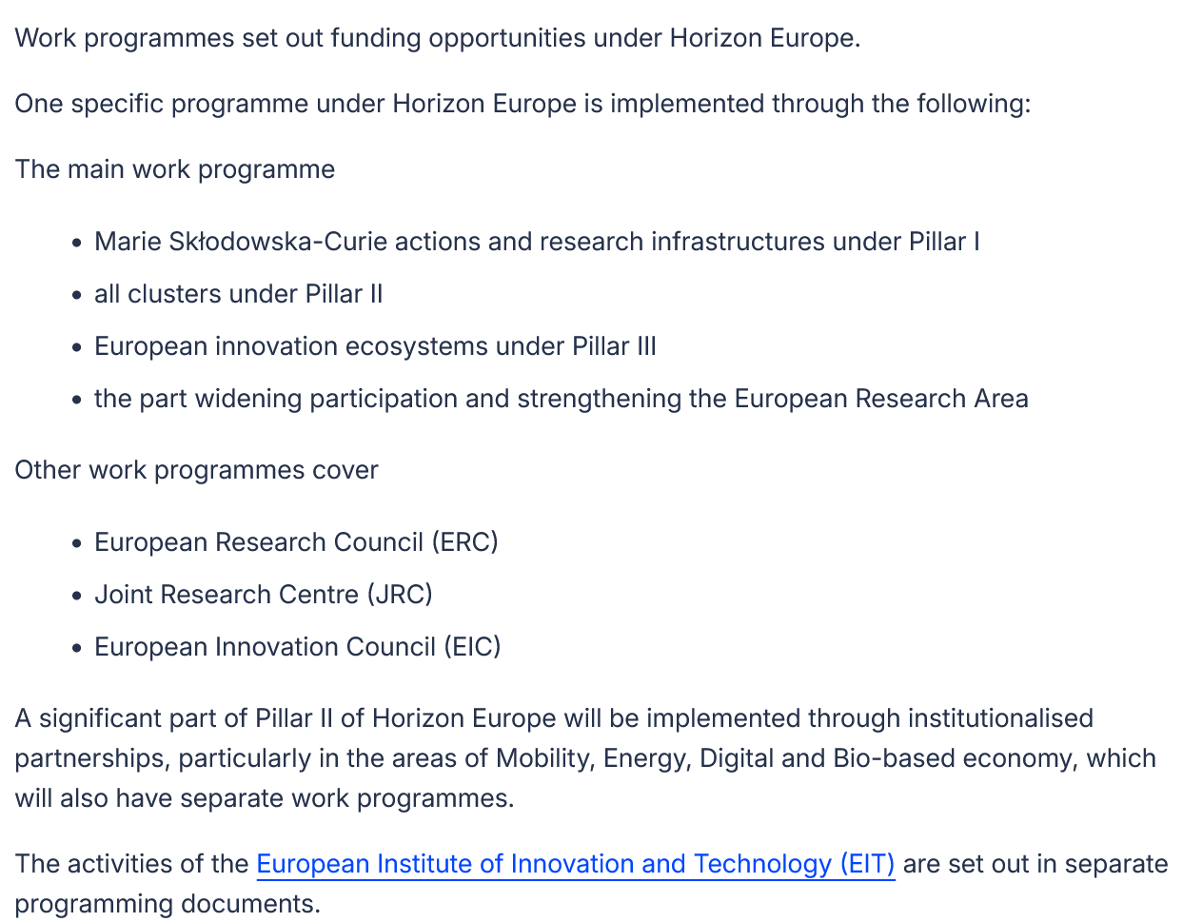
Horizon Europe (2021-27) Work Programmes
Work Programmes = series of pdf documents with:
General considerations, aims;
Calls;
Budgets;
Deadlines;
Calls and topics descriptions
WP 2021-22
WP 2023-24
WP 2025 (published 14/5/2025)
Next: WP 2026-27
(due: end 2025

Slide 6
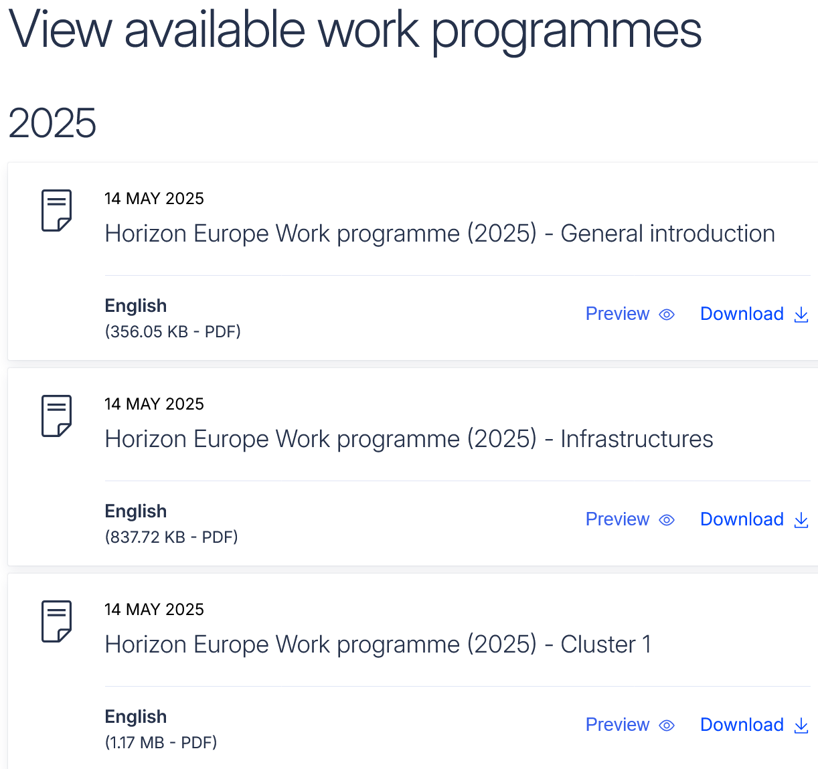

Slide 7
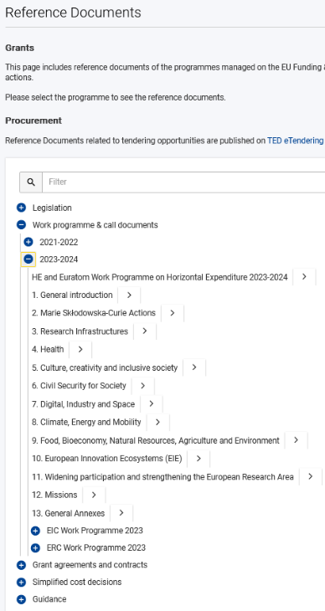
International cooperation in Horizon Europe Work Programme 2021-2022
What information do thematic
work programmes provide?
Introduction
Overview of the scheduled call(s)
Description of the topics
Call Key data:
Opening date, deadline
Type of Action (RIA, CSA, IA, etc)
indicative budget per Topic/Call
one-stage/two-stage procedure
indicative date for evaluation outcome & grant signing
Budget
https://ec.europa.eu/info/funding-tenders/opportunities/portal/screen/how-to-participate/reference-documents;programCode=HORIZON

Slide 8
To sum up…
.
All projects to be funded by Horizon Europe, address a Call to be found in a (current) Work Programme (→ you need to find a suitable for you Call)
A Call can include several Topics
The Calls/Topics in the Work Programme have an ID, a title, a budget, a deadline, the way of submission (single/two-stage) and a description
The description states the Expected Outcomes (what will happen/will be achieved AFTER the successful implementation of the project and the Scope (what activities/research work should be implemented DURING the projects lifetime
All Calls/Topics are also uploaded in the Funding & Tenders Portal of the EC

